Slide 1

Group 7 Presentation
Alex, Erik, Goitom, Johan, Pooriya, Rahwa, Tobias

Slide 2
Matches
Cup
Exploration
Alex Graham
Erik Karlkvist
Goitom Abrehaley
Johan Ljungberg
Pooriya Balavi
Rahwa Araya
Tobias Alldén
News
Events
Football
Administration

Slide 3
Alex Graham
Erik Karlkvist
Goitom Abrehaley
Johan Ljungberg
Pooriya Balavi
Rahwa Araya
Tobias Alldén
Cup
Matches
Football
News
Administration
Exploration
Events

Slide 4
Cup
News
How do we do it?
Matches
Administration
Football
Events
Exploration

Slide 5


How do we do it?
React Native
Firebase

Slide 6
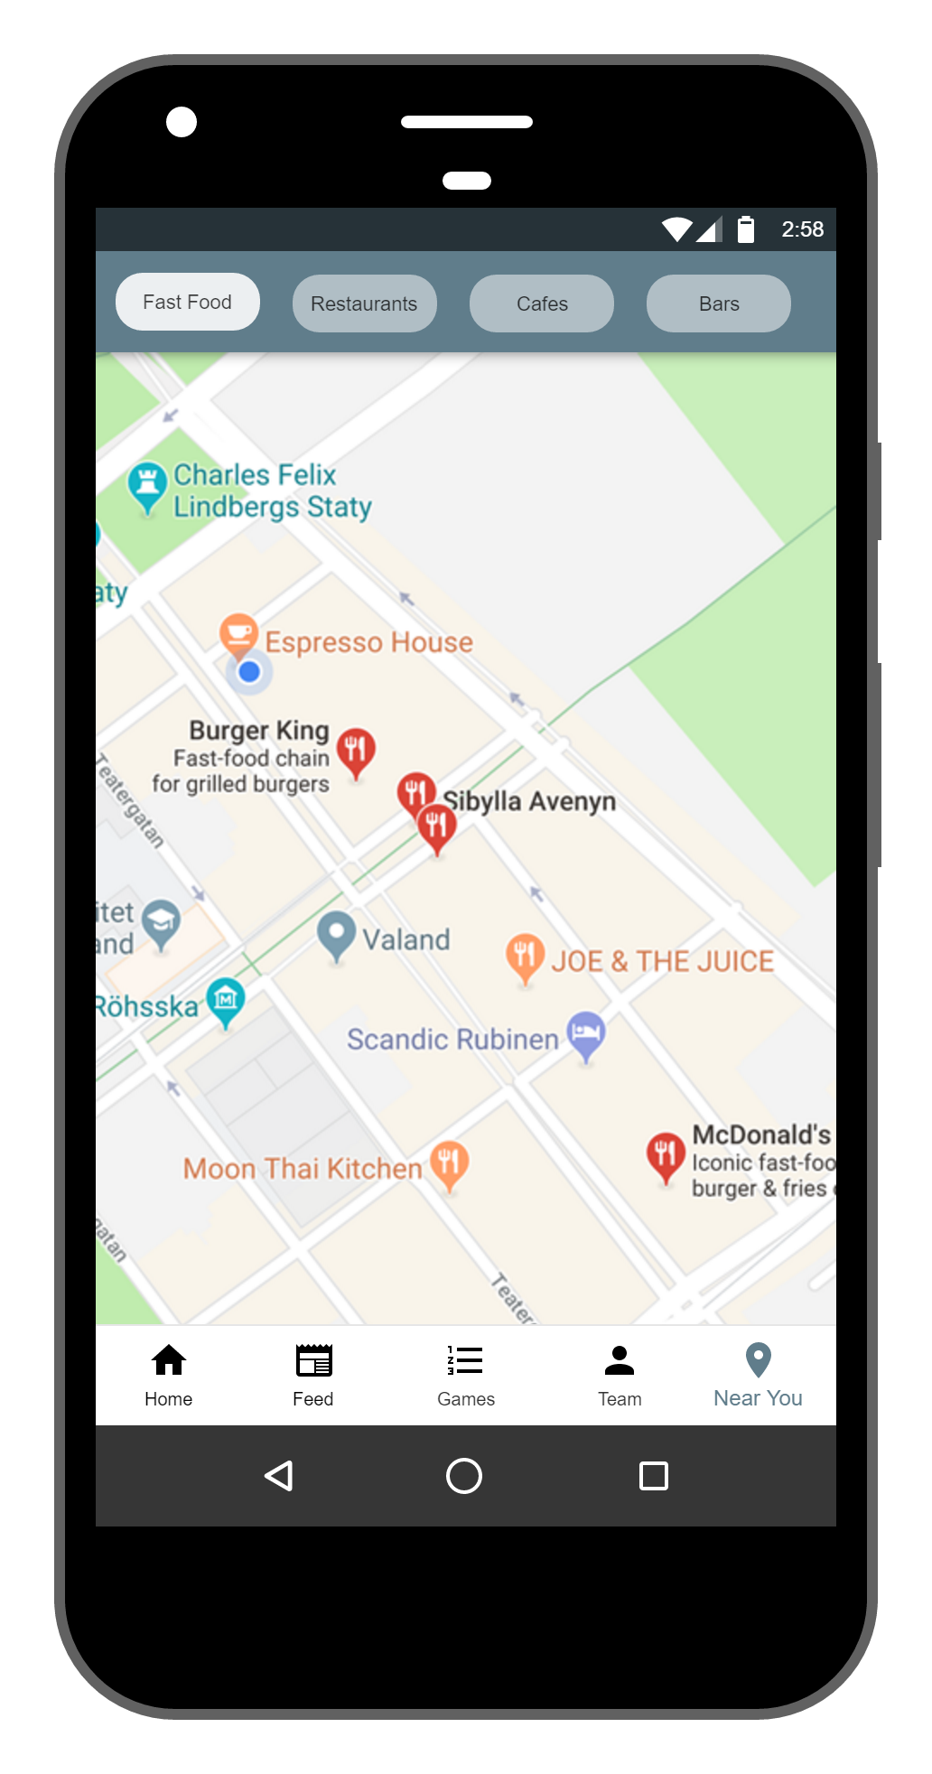



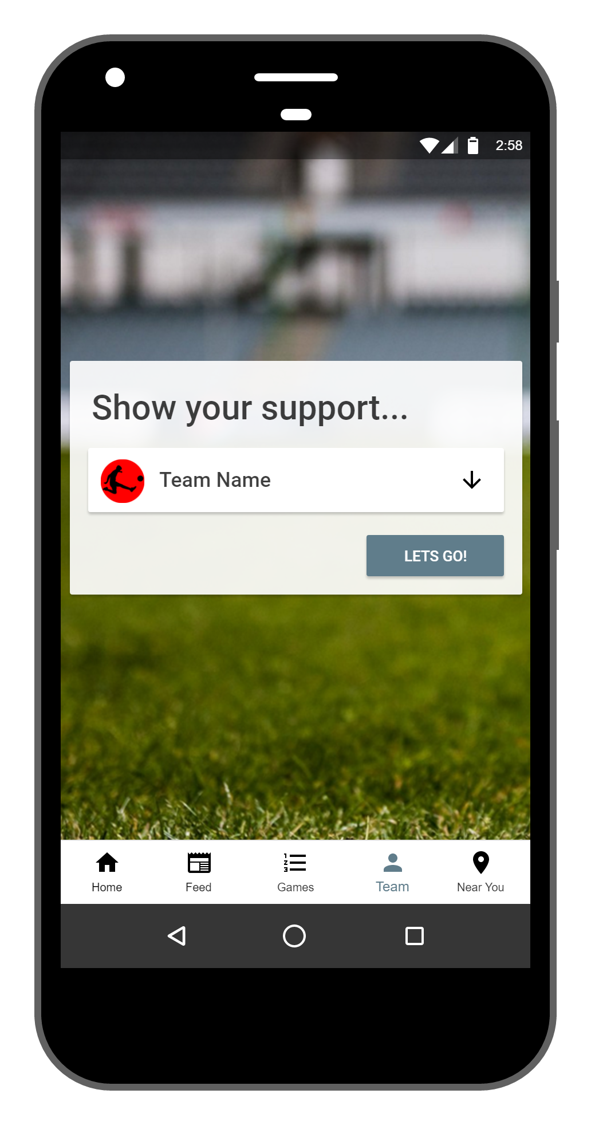
Footcity

Slide 7
Roboto Light, Medium, Bold

Slide 8
Demo
#exciting

Slide 9
Key Experiences
Scrum Board

Slide 10
Key Experiences
Scrum Board
Pair Programming

Slide 11
Key Experiences
Scrum Board
Pair Programming
Test Driven Development

Slide 12
Key Experiences
Pair Programming
Test Driven Development

Slide 13


Slide 14
Footcity

